Slide 1


WELCOME
presented by
C.Aathi muthu pandian

Slide 2


PROJECT OVERVIEW
•THIS PROJECT DEMONSTRATES THE BASIC USAGE OF CSS FLEXBOX.
•Uses display: flex
•- Aligns items in a row
•- Supports wrapping
•- Clean and beginner-friendly design

Slide 3

TECHNOLOGIES USED
•- HTML5
•- Internal CSS
•- CSS Flexbox module

Slide 4

FLEX CONTAINER PROPERTIES
•display: flex → Enables flexbox
•flex-direction: row → Items arranged horizontally
•flex-wrap: wrap → Items move to next line if needed
•gap: 50px → Space between items
•align-items: flex-start → Align items at top

Slide 5
FLEX ITEMS (BOXES)
•Each box has:
•- Fixed width
•- Padding for spacing
•- Background color
•- Centered text
•
•These boxes automatically adjust based on screen size.

Slide 6
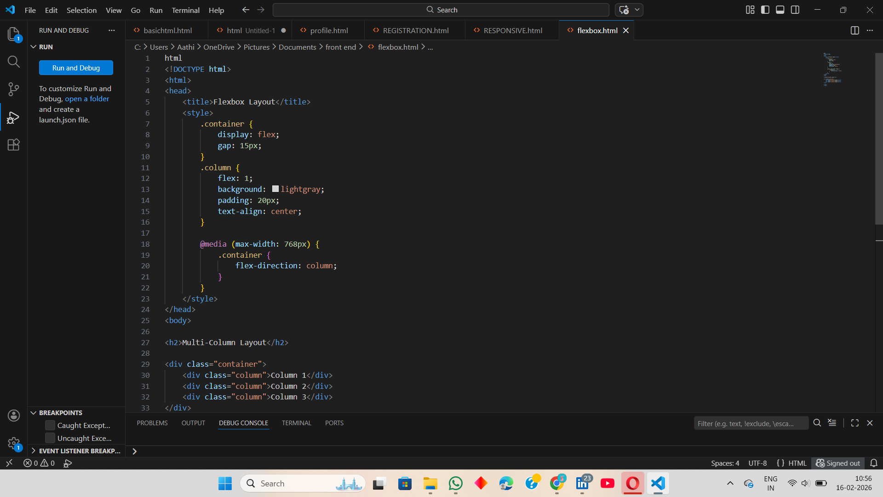
PROGRAM

Slide 7
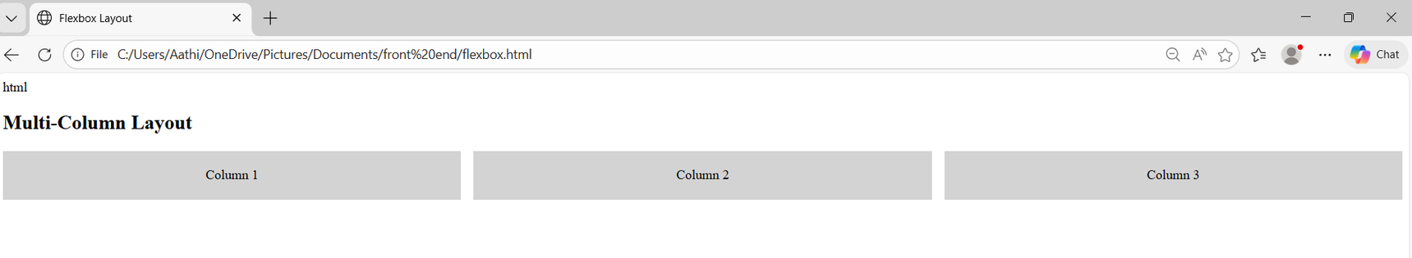
OUT PUT

Slide 8
CONCLUSION
•This example helps beginners understand Flexbox concepts.
•It is useful for building responsive layouts easily.

Slide 9
THANK YOU

